Slide 1
Java Programming Unit I – Chapter 8 Inheritance

Slide 2
Contents
Inheritance Basics
Method Overriding
Dynamic Method Dispatch
Abstract Class
Using Final

Slide 3
Inheritance Basics
Allows the creation of hierarchical classifications
Defines:
General Class (Super/Base class)
Defines traits common to a set of related items
Can be inherited by other, more specific classes
Specific Class (Sub/Derived class)
Inherits base class → Access all common traits
Also adds specific traits, that are unique to it.

Slide 4
class base
{
int x;
void dispbase()
{
System.out.println("x="+x);
}
}
class sub extends base
{
int y;
void dispsub()
{
System.out.println("y="+y);
}
}
class sample
{
public static void main(String arg[])
{
base bb=new base();
sub ss=new sub();
bb.x=10;
bb.dispbase();
ss.x=100;
ss.y=200;
ss.dispbase();
ss.dispsub();
}
}

Slide 5
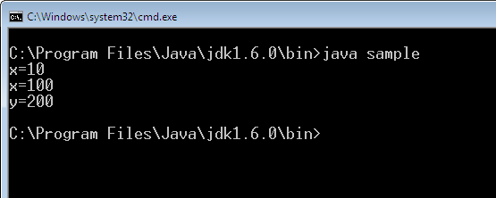
Output

Slide 6
Member Access and Inheritance
Public:
Default access
Private:
Subclass cannot access the members of the superclass that have been declared as private
Protected:
Allows access to current class, sub-class of same package, sub-class of different package.
But not to non-subclass of different package.

Slide 7
Using “Super”
Used by a subclass that needs to refer to its immediate super-class
Super has two general forms.
Calls the super-class’ constructor.
Used to access a member of the superclass that has been hidden by a member of a subclass
super() must always be the first statement executed inside a subclass’ constructor.

Slide 8
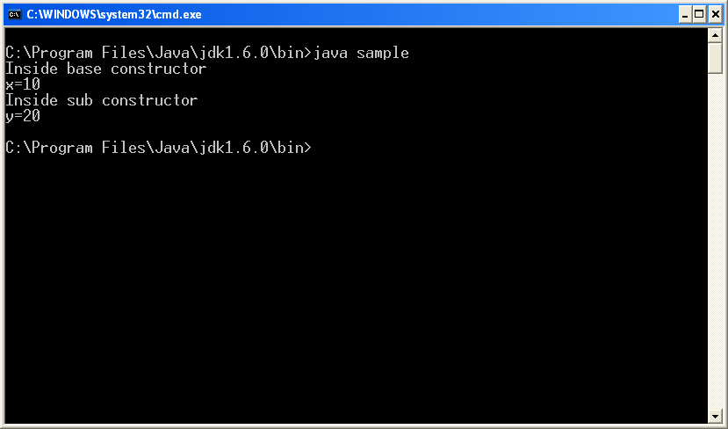
class base
{
int x;
base(int a)
{
System.out.println("Inside base constructor");
x=a;
System.out.println("x="+x);
}
}
class sub extends base
{
int y;
sub(int a,int b)
{
super(a);
System.out.println("Inside sub constructor");
y=b;
System.out.println("y="+y);
}
}
class sample
{
public static void main(String arg[])
{
sub s=new sub(10,20);
}
}

Slide 9
class base
{
int x;
void base_disp()
{
System.out.println("Inside base constructor");
System.out.println("x="+x);
}
}
class sub extends base
{
int y;
sub(int a,int b)
{
super.x=a;
super.base_disp();
System.out.println("Inside sub constructor");
y=b;
System.out.println("y="+y);
}
}
class sample
{
public static void main(String arg[])
{
sub s=new sub(10,20);
}
}

Slide 10
Types of Inheritance
Single Inheritance.
Multilevel Inheritance.
Hierarchical Inheritance.
Multiple Inheritance (Through Interface)
Hybrid Inheritance (Through Interface)

Slide 11
a) Single Inheritance
One parent class inherited by one sub class
class A
{ … }
class B extends A
{ … }
Class A
Class B

Slide 12
b) Multilevel Inheritance
Here, derived class will be inheriting a parent class and as well as the derived class act as the parent class to other class
class A
{ … }
class B extends A
{ … }
class C extends B
{ … }
Class A
Class B
Class C

Slide 13
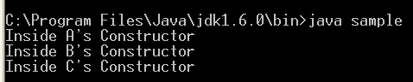
class A
{
A()
{
System.out.println("Inside A's Constructor");
}
}
class B extends A
{
B()
{
super();
System.out.println("Inside B's Constructor");
}
}
class C extends B
{
C()
{
super();
System.out.println("Inside C's Constructor");
}
}
class sample
{
public static void main(String arg[])
{
C cc=new C();
}
}

Slide 14
c) Hierarchical Inheritance
One parent class will be inherited by many sub classes
class A
{ … }
class B extends A
{ … }
class C extends A
{ … }
Class A
Class B
Class C

Slide 15
d) Multiple Inheritance
Here one class extends more than one class.
Not Directly supported in java.
Supported through Interface
Class A
Class B
Class C

Slide 16
e) Hybrid Inheritance
Hybrid Inheritance is the combination of both Single and Multiple Inheritance
As Multiple inheritance is supported through interface, Hybrid is also supported through interface
Class A
Class B
Class D
Class C

Slide 17
Method Overriding
When a method in a subclass has the same name and type signature as a method in its superclass,
Then the method in the subclass is said to override the method in the superclass.
No need of differences in argument type/number

Slide 18
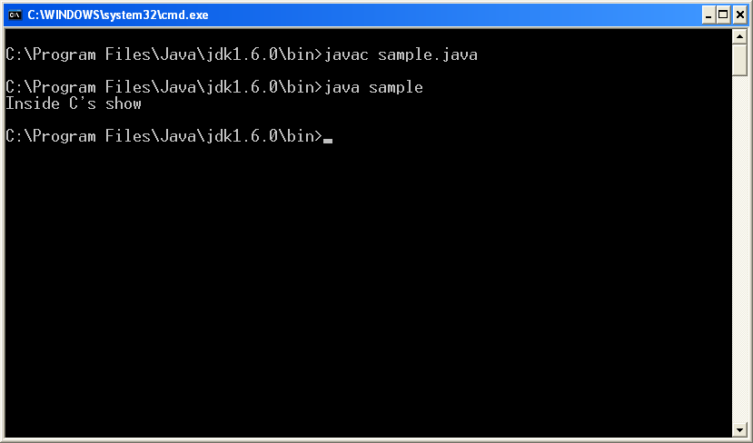
class A
{
void show()
{
System.out.println("Inside A's show");
}
}
class B extends A
{
void show()
{
System.out.println("Inside B's show");
}
}
class C extends B
{
void show()
{
System.out.println("Inside C's show");
}
}
class sample
{
public static void main(String arg[])
{
C cc=new C();
}
}
cc.show();

Slide 19
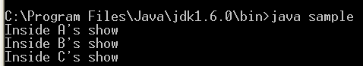
class A
{
void show()
{
System.out.println("Inside A's show");
}
}
class B extends A
{
void show()
{
super.show();
System.out.println("Inside B's show");
}
}
class C extends B
{
void show()
{
super.show();
System.out.println("Inside C's show");
}
}
class sample
{
public static void main(String arg[])
{
C cc=new C();
}
}
cc.show();

Slide 20
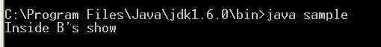
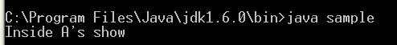
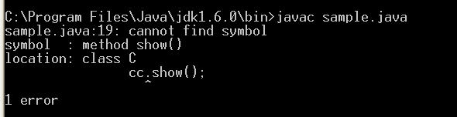
class A
{
void show()
{
System.out.println("Inside A's show");
}
}
class B extends A
{
void show()
{
System.out.println("Inside B's show");
}
}
class C extends B
{
void show()
{
System.out.println("Inside C's show");
}
}
class sample
{
public static void main(String arg[])
{
C cc=new C();
}
}
cc.show();

Slide 21
class A
{
void show()
{
System.out.println("Inside A's show; No arguments");
}
}
class B extends A
{
void show(String a)
{
System.out.println("Inside B's show; 1 argument "+a);
}
}
class C extends B
{
void show(String a, String b)
{
System.out.println("Inside C's show; 2 arguments "+a+" "+b);
}
}

Slide 22
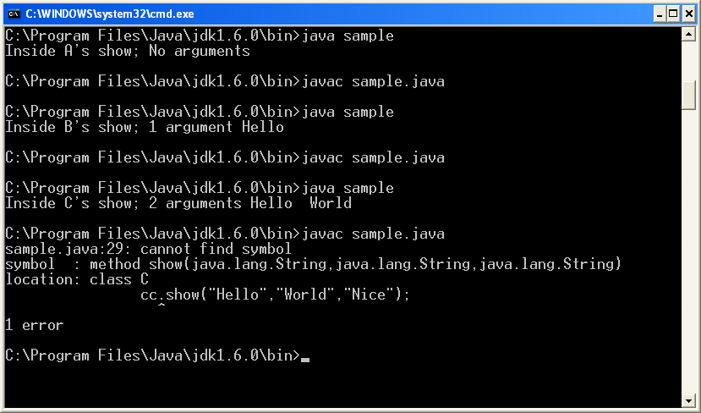
class sample
{
public static void main(String arg[])
{
C cc=new C();
}
}
cc.show();
cc.show(“Hello”);
cc.show(“Hello”, “World”);
cc.show(“Hello”, “World”, “Nice”);

Slide 23
Dynamic Method Dispatch
Dynamic method dispatch is the mechanism by which a call to an overridden method is resolved at run time, rather than compile time
This is called as Run-time Polymorphism

Slide 24
class A
{
void show()
{
System.out.println("Inside A's show");
}
}
class B extends A
{
void show()
{
System.out.println("Inside B's show");
}
}
class C extends B
{
void show()
{
System.out.println("Inside C's show");
}
}
class sample
{
public static void main(String arg[])
{
A aa=new A();
B bb=new B();
C cc=new C();
A rr;
rr=aa;
rr.show();
rr=bb;
rr.show();
rr=cc;
rr.show();
}
}

Slide 25
Using Abstract Classes
Define a superclass that declares the structure of a given abstraction without providing a complete implementation of every method
Superclass only defines a generalized form that will be shared by all of its subclasses, leaving it to each subclass to fill in the details
abstract type name(parameter-list);
Condition: a subclass must override them

Slide 26
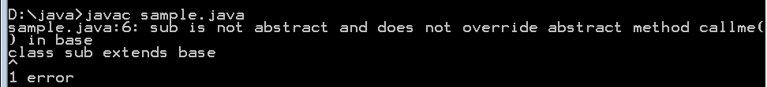
abstract class base
{
abstract void callme();
}
class sub extends base
{
}
class sample
{
public static void main(String args[])
{
sub ss=new sub();
}
}

Slide 27
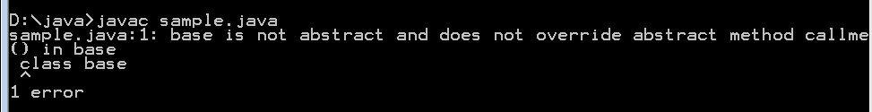
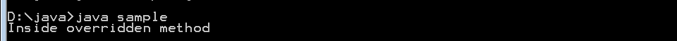
abstract
class base
{
abstract void callme();
}
class sub extends base
{
void callme()
{
System.out.println("Overridden Method");
}
}
class sample
{
public static void main(String args[])
{
sub ss=new sub();
ss.callme();
}
}

Slide 28
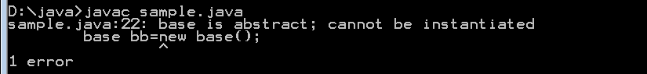
abstract class base
{
void get()
{
System.out.println("Inside base class get method");
}
abstract void callme();
}
class sub extends base
{
void callme()
{
System.out.println("Inside overridden method");
}
}
class sample
{
public static void main(String args[])
{
base bb=new base();
bb.get();
sub ss=new sub();
ss.callme();
} }

Slide 29
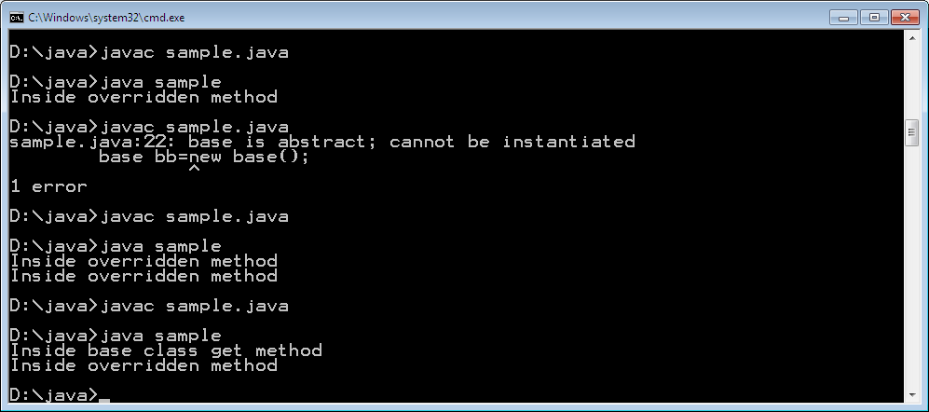
abstract class base
{
void get()
{
System.out.println("Inside base class get method");
}
abstract void callme();
}
class sub extends base
{
void callme()
{
System.out.println("Inside overridden method");
}
}
class sample
{
public static void main(String args[])
{
sub ss=new sub();
ss.get();
ss.callme();
} }

Slide 30
“final” with Inheritance
3 uses of final
Used to create constants
final int a=10;
Prevent Overriding
Prevent Inheritance

Slide 31
Prevent Overriding
class A {
final void meth() {
System.out.println("This is a final method.");
}
}
class B extends A {
void meth() { // ERROR! Can't override.
System.out.println("Illegal!");
}
}

Slide 32
Prevent Inheritance
final class A {
//...
}
class B extends A { // ERROR! Can't subclass A
//...
}

Slide 33
Tutorial Question 3
Calculate the area of Rectangle, Square and Triangle. Declare a method “area()” that computes the area by having necessary arguments. Apply method overloading to compute area of each shape
Class: Shape
Method 1: Rectangle
area (int length, int breath)
area=length*breath
Method 2: Square
area (int side)
Area=(side)²
Method 3 :Triangle
area(float height, int base)
Area=1/2*h*b

Slide 34
Tutorial Question 4
Design a “Pay roll” processing system, that computes salary of employees of the following categories
Manager
Officer
Labor
Employee
(eid, name, desig)
Manager
Allow: DA, CCA, HRA
Ded: Loan and PF
Salary = Basic+Allow-ded
Officer
Allow: DA
Ded: PF
Salary=Basic+Allow-ded
Labor
No.of Hrs worked
Pay/hr
Salary=hrs*pay

Slide 35
Thank You

